Slide 1



Slide 2
Stronger, Smarter, Faster
Angular 2
Notes:
BE EXCITED!!!!

Slide 3


Slide 4

Joe Eames
Jim
Cooper
Me
@josepheames
Joeeames.me
www.pluralsight.com
www.ng-conf.org
http://devchat.tv/js-jabber
http://devchat.tv/adventures-in-angular

Slide 5
Tweet
#bestTalkEver
#ngMasterJoe
#IAmYourFather
#BearAMedic

Slide 6
Thanks
Igor Minar
Clark Sell

Slide 7
Agenda
Questions
Current State
Benefits
Transpilers
Directives & Components
Migration

Slide 8
Questions
Notes:
Who uses ng1
How big? 5k LOC? 20k? 50k? 100k?
Who has used react? In production?
Who primarily does front end?
Who is full stack?
Who has encountered perf problems?
Who feels like we need an ng2?
What probs do you have with ng1?
What do you want in ng2?
Who has seen anything about angular 2?
Who is using/has used ES6 in a prod app?
Who has used es6 at all?
What do you think of ES6?

Slide 9
Current State
Developer Preview
CHANGING
CONSTANTLY
UNSTABLE
Release:
Anyone’s guess
Notes:
Difficult to find a combination of tools that works

Slide 10
Benefits
Everything from Angular 1
Speed
Simpler Mental Model
DOM Goodness

Slide 11
Development Process Options
With Transpiler
Without Transpiler
Notes:
The Angular Team built NG2 to be a forward looking framework. Something that would still be relevant in 5 years.

Slide 12
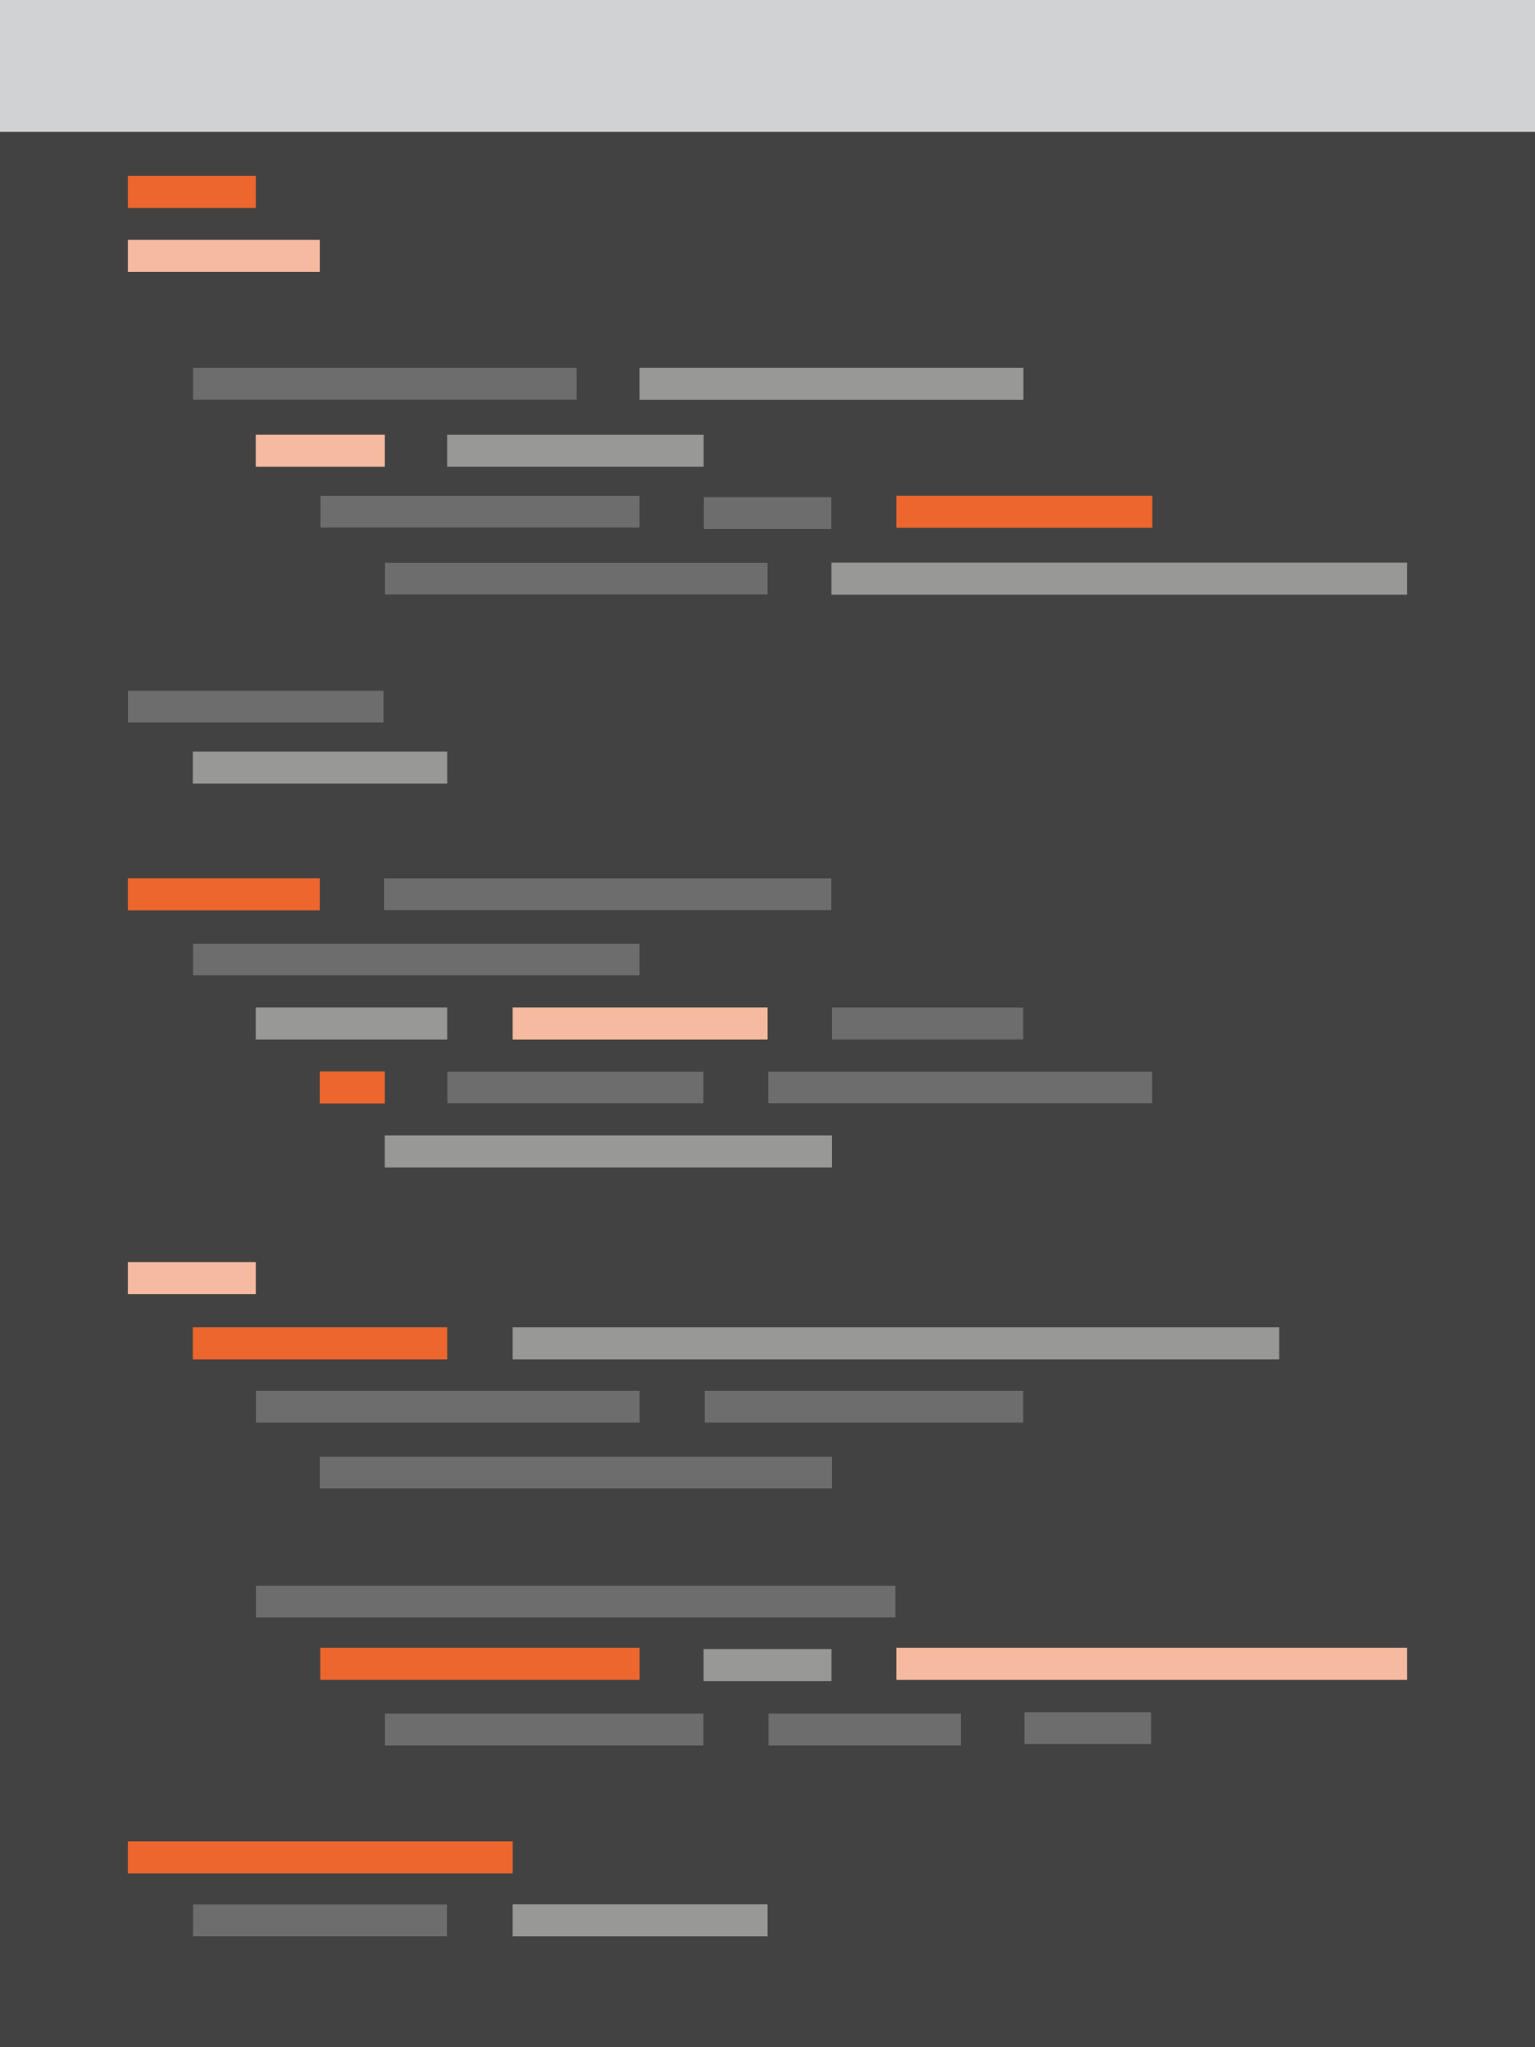
Transpilers
Convert something to JavaScript
TypeScript
JavaScript

Slide 13
Development Process
ES5
Deploy
server
ES5
Request
Browser
(can only run ES5)

Slide 14
Development with Build-Time Transpiler
Dev
ES6+
server
Browser
(ES5 only)
Deploy
ES5
Request
Transpiler
ES5
Notes:
Can use a watcher to make this painless

Slide 15
Development with Run-Time Transpiler
Browser (ES5)
Dev
server
ES6+
ES6+
Deploy
ES6+
Request
Transpiler
ES5
Notes:
Bad: adds load to client. Useful only for demo projects

Slide 16
Transpiler Options
Traceur
Build Time
Run Time
Babel
TypeScript
Notes:
Around 15 mins

Slide 17
Demo
https://github.com/joeeames/ng2-thatconf
Notes:
Around 15 mins
START ON DEMO
Do index.html
Then app.js
Show next slide

Slide 18
Directives in Angular 1
Components
-View
-Element
-Common
-Widgets
Decorators
-No View
-Attributes
-Rare
-Event Handlers
Structural
-DOM Insertion/Deletion
-Almost Never Built
- ng-repeat & ng-if

Slide 19
Directives in Angular 2
Components
-View
-Element
-Common
Directives
-No View
-Attributes
-Even Rarer
??
Notes:
Show app.js

Slide 20
ES6+ VS ES5
var HelloComponent = function () {
// code goes here
};
HelloComponent.annotations = [
new angular.ComponentAnnotation({
selector: 'hello-cmp'
}),
new angular.ViewAnnotation({
template: 'Hello World!'
})
];
@Component({
selector: 'hello-cmp'
})
@View({
template: 'Hello World!'
})
class HelloComponent {
// code goes here
}

Slide 21
ES6+ VS ES5
var HelloComponent = function () {
// code goes here
};
HelloComponent.annotations = [
new angular.ComponentAnnotation({
selector: 'hello-cmp'
}),
new angular.ViewAnnotation({
template: 'Hello World!'
})
];
@Component({
selector: 'hello-cmp'
})
@View({
template: 'Hello World!'
})
class HelloComponent {
// code goes here
}

Slide 22
ES6+ VS ES5
var HelloComponent = function () {
// code goes here
};
HelloComponent.annotations = [
new angular.ComponentAnnotation({
selector: 'hello-cmp'
}),
new angular.ViewAnnotation({
template: 'Hello World!'
})
];
@Component({
selector: 'hello-cmp'
})
@View({
template: 'Hello World!'
})
class HelloComponent {
// code goes here
}

Slide 23
Component Hierarchy
App
Child Component 1
Child Component 2
Child Component 3
Notes:
Back and forth with code

Slide 24
Component Hierarchy
<body>
<app></app>
</body>

Slide 25
Component Hierarchy
<body>
<app></app>
</body>

Slide 26
Component Hierarchy
<body>
<div>
<top-nav></top-nav>
<h1>Welcome to Pluralsight</h1>
<course-list></course-list>
</div>
</body>

Slide 27
Component Hierarchy
<body>
<div>
<top-nav></top-nav>
<h1>Welcome to Pluralsight</h1>
<course-list></course-list>
</div>
</body>

Slide 28
Sample Application
todo-app
todo-list
new-item
Notes:
show working demo
Back to code,
show app.html
Show new-item.js & new-item.html
Show todo-list.js & html
when talking about binding to properties, show next 3 slides

Slide 29
DOM Nodes
body
div
button
onclick
checkbox
checked

Slide 30
Checkbox Checked
<input type=“checkbox” checked=“false”>
Notes:
Example to show:
http://plnkr.co/edit/VS6Fw9Cl9O6FFPWPEFzl?p=preview

Slide 31
DOM Nodes
body
div
button
onclick
click
checkbox
checked
checked

Slide 32
Dual Binding
[ ] to bind out/set properties
( ) to bind in/capture events
Notes:
Add custom event if time permits

Slide 33
Migration
New Router
Controller As
Side by Side
ng-vegas Videos
(www.ng-vegas.org)

